Slide 1
Project work
gruppo 2 - software architecture design 2024/2025
1st sprint release presentation

Slide 2
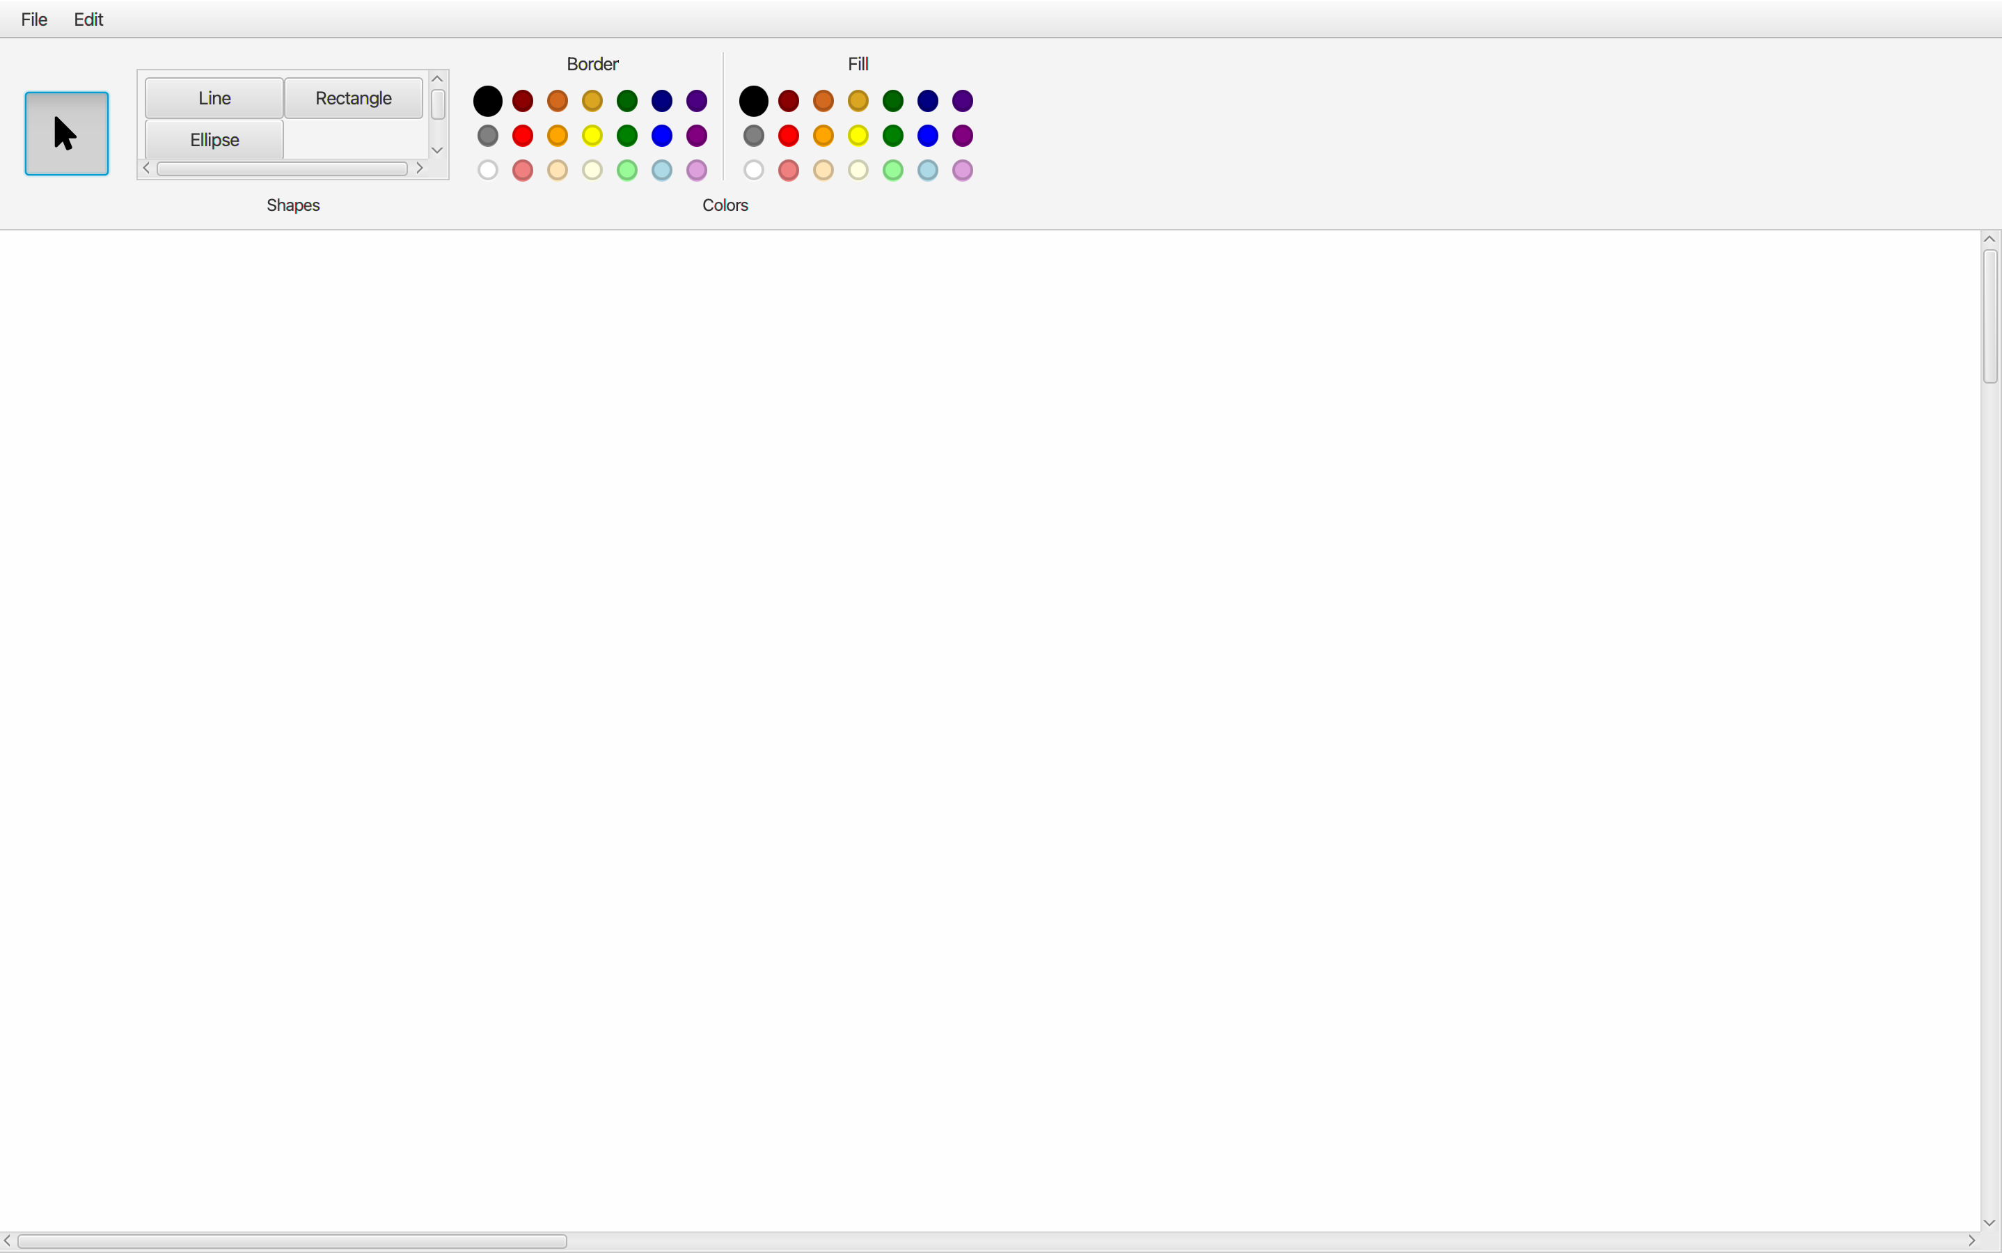
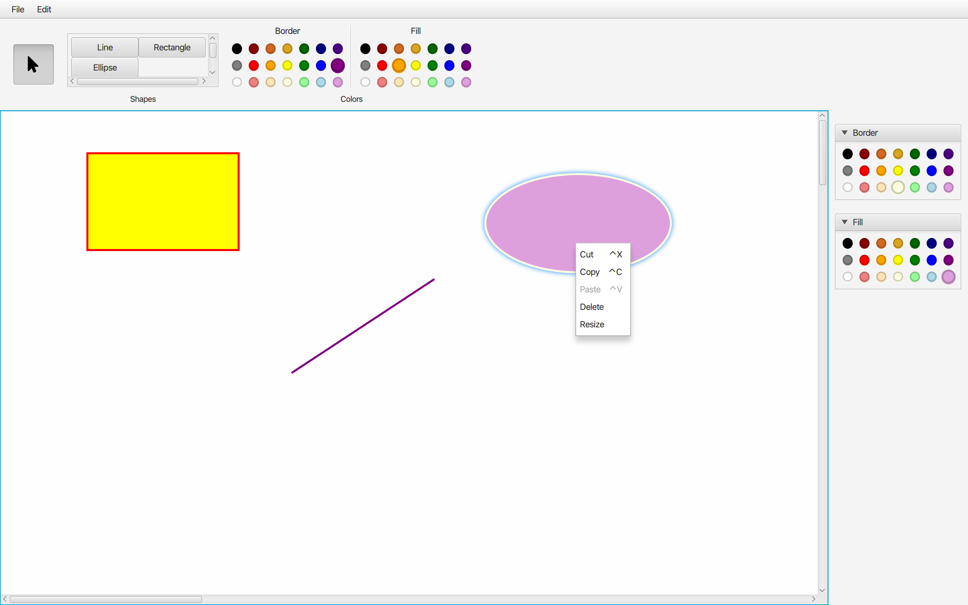
1st sprint release
(Fig. 1) Effective empty canvas
(Fig. 2) Shapes options

Slide 3
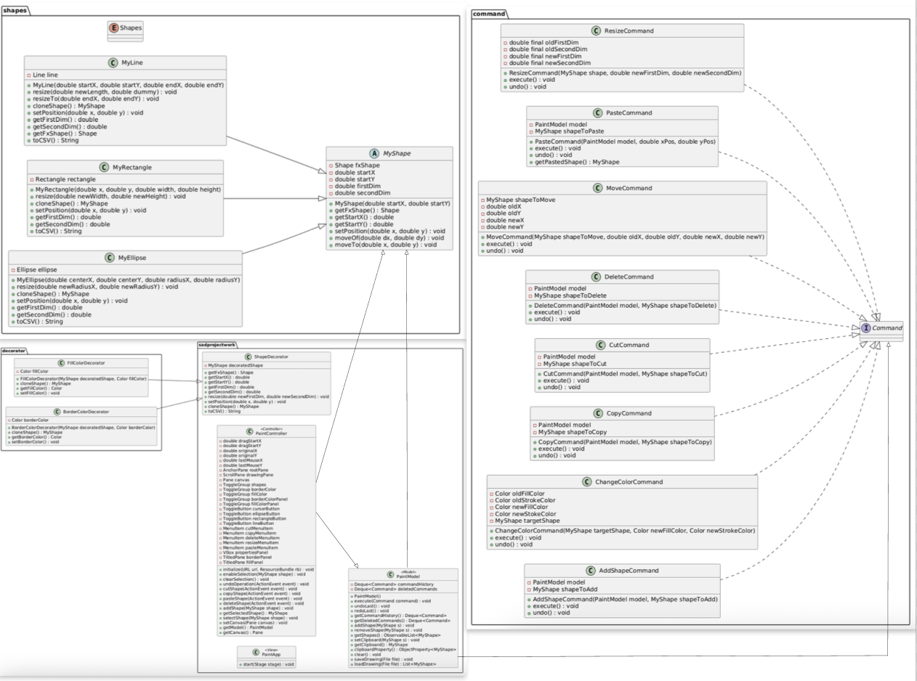

1st sprint release - CLASS DIAGRAM
(Fig. 3) Class Diagram produced up 1st sprint

Slide 4
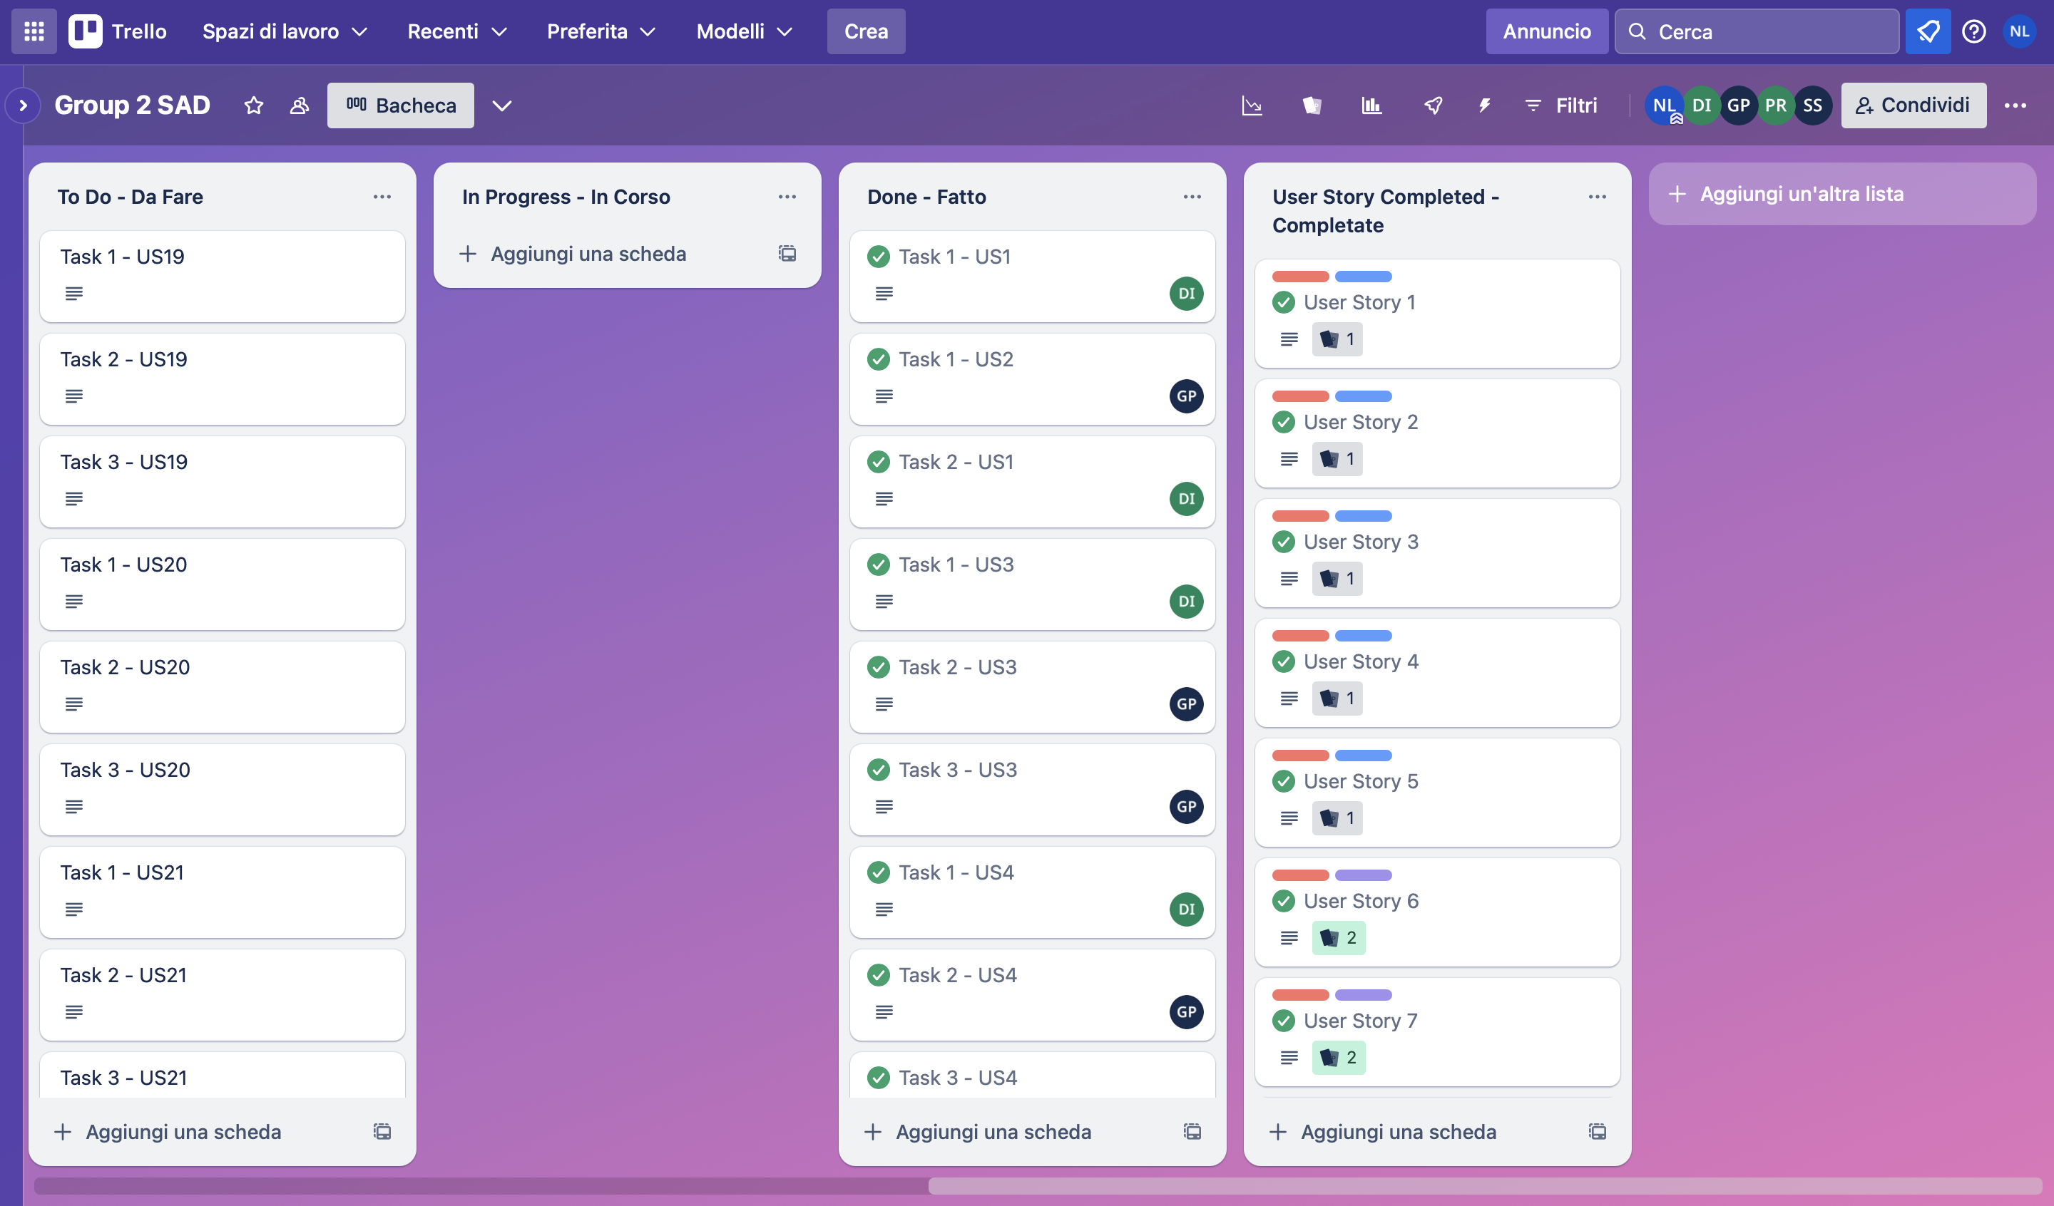
1st sprint review
All user stories and all tasks related to them, planned for the 1st sprint, have been completed.
For this reason, the Project Velocity can continue to be 32 story points.
No additional user stories have been added to those already planned initially.
The designed design patterns were respected.
(Fig. 4) Trello Board at the end of 1st sprint

Slide 5
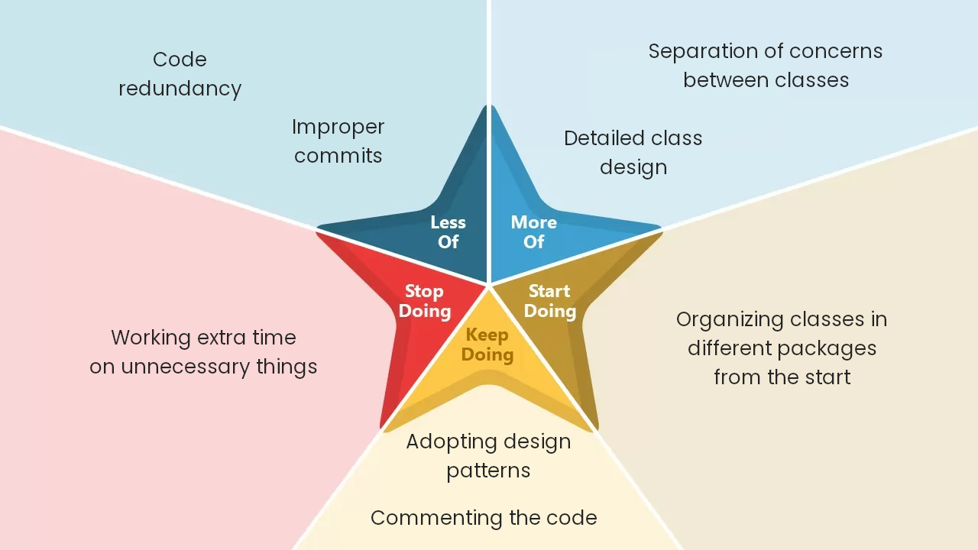
1st sprint retrospective

Slide 6
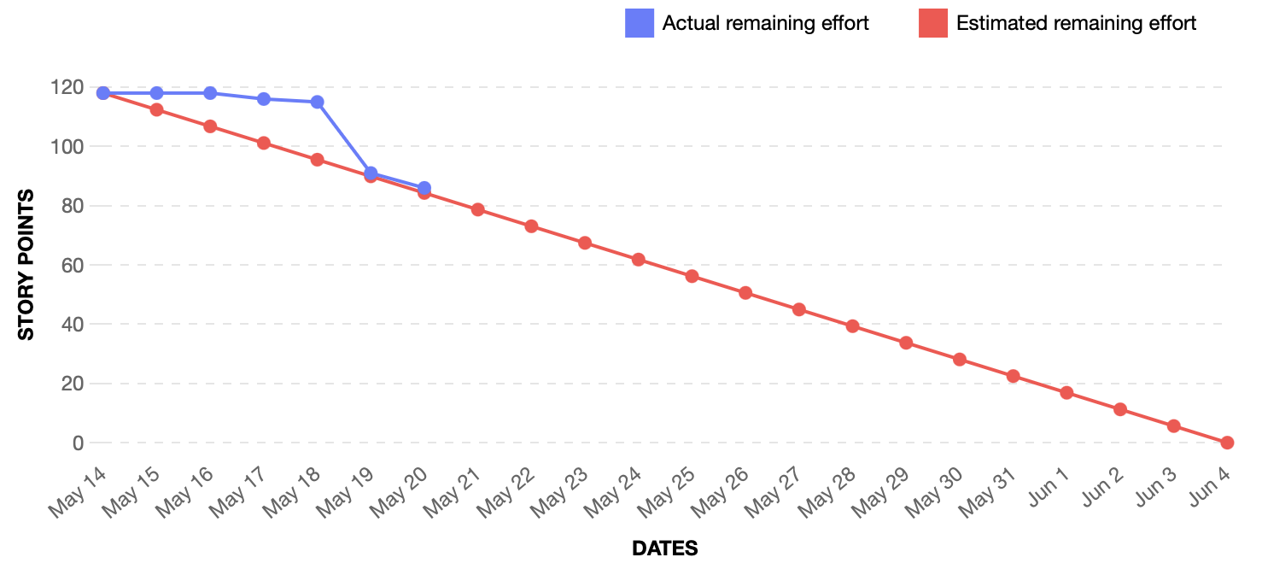
Burndown chart
(Fig. 5) Burndown chart at the endo of 1st sprint

Slide 7
2nd sprint backlog
The second sprint includes:
User Stories inherent functionalities related to the management of the arrangement of overlapping shapes;
User Stories inherent supporting functionalities such as zoom and grid;
In addition, features such as text input, polygon creation and some of the figure distortion features will be handled.
On the right there are some examples.
#US | Description | Priority | SPs
19 | To the front functionality | Should | 3
21 | Zoom | Could | 3
23 | Grid | Could | 3
25 | Arbitrary Polygon | Could | 5
26 | Text as a shape | Could | 3

Slide 8
THANK YOU for attention
Iannone Davide
Lomazzo Noemi
Petrone Gianluca
Sirica Simone

